Slide 1
Why should your next secure design be PUF based
IPs securing ICs
Vincent TELANDRO, Sales Manager
Christophe TREMLET, Marketing & Sales Director

Slide 2
Hierarchy in Security Measures
HW
Software
cryptography
Human

Slide 3
Cryptography
Confidentiality
Only the intended recipient of a message can decrypt its contents
Cryptography
Integrity
The recipient can verify that the message has not been altered
Authenticity
The recipient can verify that the sender is who he/she claims to be

Slide 4
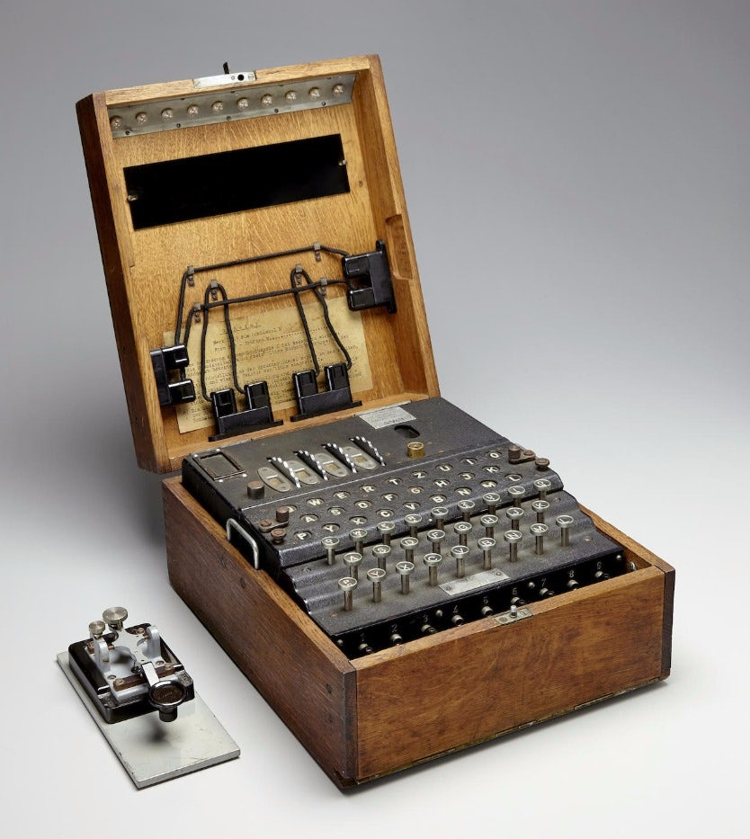
Modern Cryptography
Secret algorithm
Public algorithm / Secret key
1919
Enigma
1971
Lucifer
1975
DES
1977
RSA
1991
DSA
1992
ECDSA
1999
TDES
2000
AES
plaintext
AES
roundkey(1)
for i=1 to N
SubBytes
SubBytes
ShiftRows
ShiftRows
MixColumns
roundkey(N)
roundkey(i)
ciphertext

Slide 5
Symmetric Cryptography
secret key
secret key
plaintext
ciphertext
plaintext
Encryption
Decryption
Enc ( secret key ; plaintext )
Dec ( secret key ; ciphertext )

Slide 6
Symmetric Mutual Authentication
Smartcard
Terminal
ID?
ID
ID2K
K
RNG
RNG
Random number?
RN_{T}
K
RN_{S}
RN_{S}
II
Enc( K ; RN_{T}|| RN_{S} )
Enc( K ; RN_{S}|| RN_{T} )
I
Yes
“ = “ ?
No
Yes
“ = “ ?
No
Terminal
authenticated
Terminal not
authenticated
Smartcard
authenticated
Smartcard not
authenticated

Slide 7
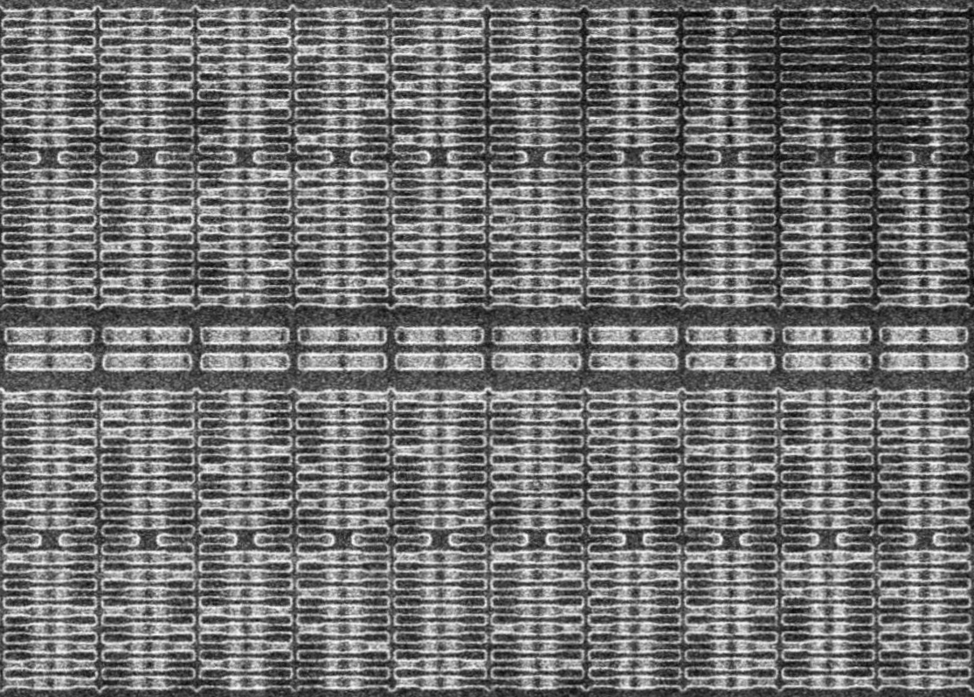

Secret Key – Attacks
Non-invasive attacks
Invasive attacks
PCB
SoC
  Passive (observation)
  On-board probing
  Side-channel attacks
  Active (perturbation)
  Over/under V, T° or clock
  Voltage, laser, clock or EM glitchs
  Chemical & laser etching
  On-chip microprobing
  Layout reconstruction
  Memory content recovery
  Electron Beam Tester (EBT)
  FIB-SEM nanofabrication
K
3V

Slide 8
Secret Key – Countermeasures
Obfuscation
Bus scrambling
Random P&R
Shield: metal mesh
Power randomisation
Protect
keys
Cryptography
Key diversification
Memory encryption
Sensors
Voltage
Temperature
Clock
Laser & EM pulses

Slide 9
Physical Unclonable Function (PUF)
Principle
Acts as a device fingerprint
Generates a per-chip unique identifier
Exploits the random variations of the devices’ parameters
Challenges
Unclonable: robust against counterfeiting
Uncontrollable: robust against invasive attacks
Unpredictable: robust against reverse engineering
Invariant: stable across voltage, temperature and aging

Slide 10
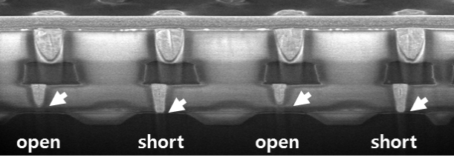
PUF – Examples
Delay
based
Arbiter
Ring oscillator
Glitch
Arbiter
0/1
0
1
0
1
1
0
V_{DD}
V_{A}
I₁
V_{DD}
A=1
Memory
based
SRAM
Latch
I₁ < I₂
V_{DD}
A
I₂
B
I₁ > I₂
0
A=0
0
t
Process
based
V_{GS} or V_{DS}
Via
0
1
0
1

Slide 11
Invia’s PUF – Principle (patented)
Digital
controller
128-bit register
Comparator
1,1
1,2
1,16
out
…
1 1 1 0 1 0 0 1
I_{B} > I_{A} → out = 1
I_{B} ≤ I_{A} → out = 0
2,1
2,2
V_{DD}
I_{A}
I_{B}
PUF
core
8,16
I_{bias}
sel[0]
Selector
sel[127]
8,1
V_{bias}
I_{A}[0]
I_{B}[0]
I_{A}[127]
I_{B}[127]
I_{A}[0:127]
I_{B}[0:127]
V_{bias}
sel
Selector
Biasing
7
128-bit
register
I_{A}
I_{B}
out
Comparator
Biasing
PUF cell 1,1
PUF cell 8,16

Slide 12
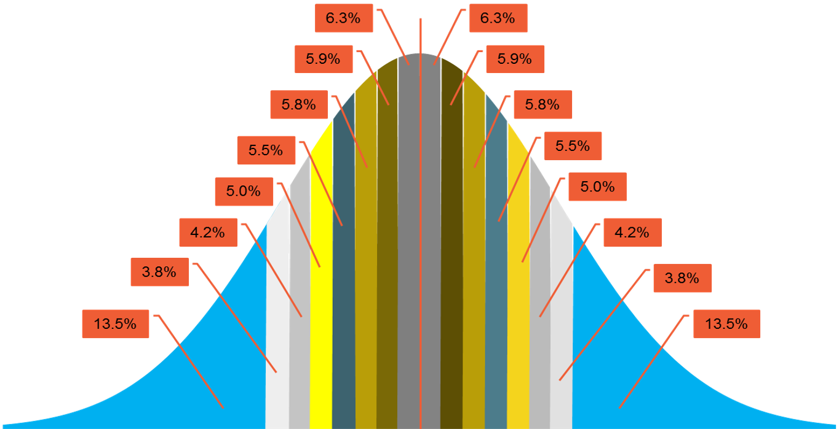
Invia’s PUF – Characteristics
I_{A}
I_{B}
MN_{A}
I_{A}
MN_{B}
I_{B}
D_{A}
D_{B}
ΔI = I_{B} – I_{A}
S_{A}
S_{B}
MN_{A}
MN_{B}
PUF cell - Schematic
MN_{B}
MN_{A}
PUF cell - Layout
128-bit
PUF core
UMC 55 nm
Sigma = 4.5 (1.35 ppm)
Silicon area < 0.01 mm²
Operating cons. < 10 µA
Standby cons. < 10 nA
0
out = ‘0’
out = ‘1’

Slide 13
Invia’s PUF – Benefits
Benefits
Compact: relatively small silicon footprint
Low-power: consumption significantly smaller than most aternatives
Robust: can be fully simulated at transistor level using a standard flow
Stable: sigma optimized by design; embedded margin check
Secure: active monitoring of the sub-blocks’ integrity (pending patent)
Scalable: the smaller the node, the better the gaussian distribution
Certifiable: can be mathematically modeled

Slide 14

Takeaways
INVIA, a Thales company
  Conducts exhaustive security audits
  Assists companies in securing their systems
  Delivers silicon-proven IPs part of EAL5+ ASICs
  Protects more than 2.0 billion deployed devices
Thank you for your attention

