Slide 1
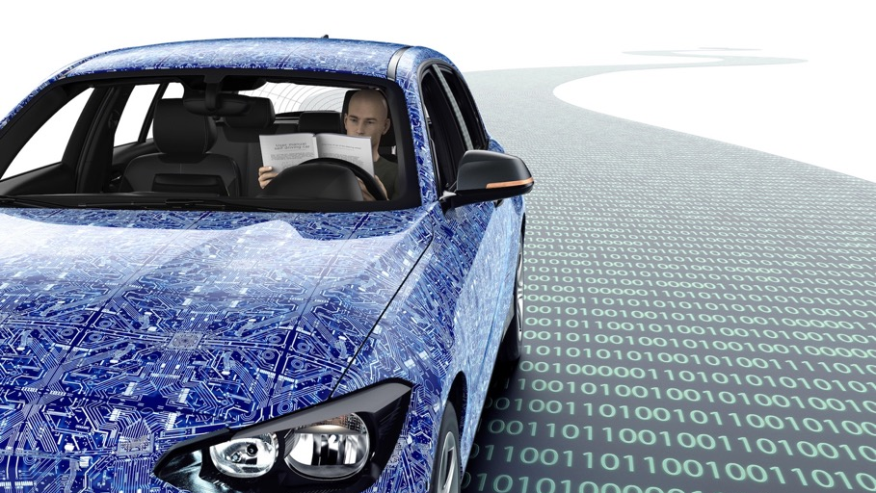
Automotive Challenges
Addressed by Standard and
Non-Standard
Based IP
D&R September 2019
Meredith Lucky
VP of Sales, CAST, Inc.

Slide 2
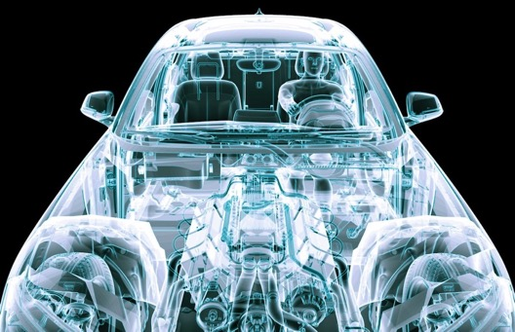
Increasing Needs/New Challenges
Integration of over 100K sensors and
500 processors
Live video streaming
from >= 10 cameras
Mission-Critical Autonomous Driving Systems
What IP is needed in these systems as they evolve?
Notes:
Connected car – Audio, Visual, in-vehicle M2M, external communications
Internal M2M uses cellular and wireless communications like wifi and bluetooth – leveraging on IoT

Slide 3


Increasing Needs/New Challenges
Applicable IP cores are small, low-power, fast (low-latency), easy to integrate, and don’t require processor intervention!
Individual IP cores
  Processors – R8051XC2, BA22, GEON
  Interconnect – CAN, LIN, SENT, Hardware Stacks, Automotive Ethernet
  Video and image needs – JPEG, JPEGLS, H.264, WDR/HDR
  Data Storage – GZIP
  Security – AES, GEON
Integrated in Sub-System Reference Designs
Implemented in Automotive Ethernet Reference Designs
Notes:
Summary of the presentation: With all the new connectivity and challenges in the Automotive industry with infotainment, ADAS, etc. - surprise: old standards like CAN, LIN and Ethernet are still the high-tech backbone.
ADAS - Advanced Driver Assistance Systems
ASIL Automotive Safety Integrity Levels) risk classes: ASIL A for assist (lowest) ASIL D for automation (highest)
SAE International created the J3016 standard: level 0-lowest to fully self-driving level 5-highest
Error Detection – hardware redundancy and ECC

Slide 4
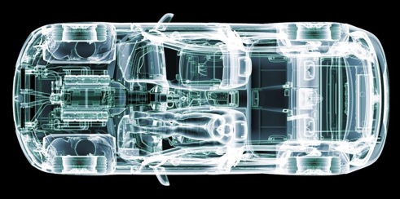
Communications in Vehicle Networks Today
CAN
1Mbps
Engine
Seatbelts
Audio
Radar
Navigation
Instruments
Climate
LIN
19.2 kBaud
Wipers
Sensors
Mirror
Doors
Seats
Lights
Turn Signals
Window
Locks
FlexRay
10Mbps
deterministic
Brakes
Advanced
Driver
Assistance Systems
(ADAS)
MOST
150 Mbps
Speakers
Radio
Navigation
GPS
Ethernet
100 Mbps
Diagnostics
Backup Cameras
CAN Safety
Seatbelt
Airbags
Notes:
CAN <1Mbps so not good for sending messages >100 times/sec updates, good for mechanical sensor info where the amount of data is limited and low bandwidth
LiDAR – Light Detection and Ranging (determine distance)
MOST – Media Oriented Systems Transport – fiber, daisy-chained or dedicated
ECU – Electronic Control Units for sensors and nodes

Slide 5
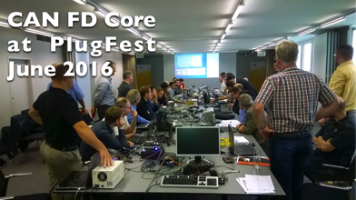
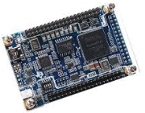
Example of a Robust Low-Risk IP Core: CAST CAN2.0/CAN-FD
Survived
three
CIA
Plug Fests
In production use
Avery VIP available
Reference design board
for easy evaluation
Notes:
Plug Fests-
Real-world testing: diverse
topologies, timing challenges,
many vendors
Proven with all
popular transceivers
Refrence design –
Software
Sample low-level drivers
Sample embedded application
Hardware
Complete MCU with CAN Controller Interface
Debug Pod for MCU Software Development
PHY Daughter-Card using OnSemi’s NCV7340-4 or NCV7351

Slide 6
CAN-CTRL: Functional Safety
Optional functional safety features:
  ECC memory protection: ECC detects single and double errors and corrects single errors
  Spatial redundancy: Inner logic is doubled and partial outputs are automatically compared
ISO-26262 certification package
  Complete IP core package plus
  RTL with safety features
  FMDEA results & Safety Manual
DAL-B Ready
ISO 26262

Slide 7
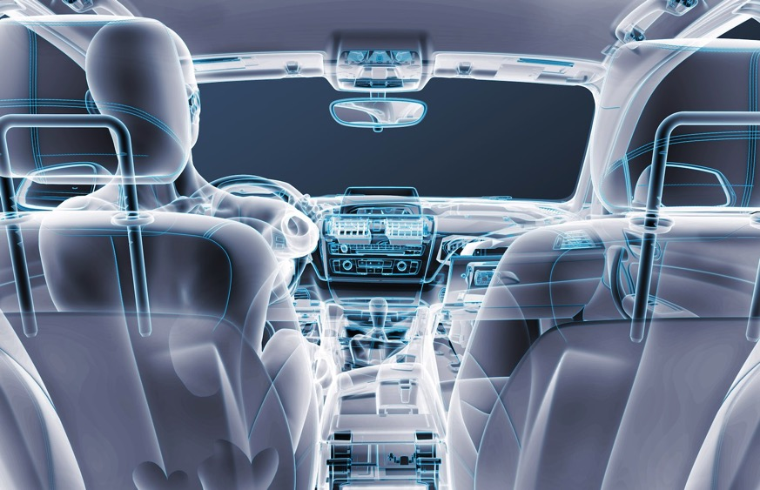
Increasing Needs for Real-Time Response
Need real-time response from hundreds of sensors and cameras
Notes:
More video channels – send over different networks fo infotainment, adas, engine control
Video used in critical applications – low latency guarantee
Multiple ethernet networks to handle different priorities

Slide 8
Automotive Ethernet – Time Sensitive Network
  TSN enables a predictable, deterministic, delivery time for time-aware application development.
  IEEE 802.1QAS for providing a common time reference to all devices participating in the real-time network
  IEEE 802.1Qav/bv for time-aware traffic scheduling
Notes:
TCP’s handshaking make delivery time long and unpredictable
AVB Audio/Video Bridging IEEE 802.1 – standard replaced by TCN
Enables time-aware application development
Provides Alarm: Dedicated host-interrupt line is asserted at a specific absolute time. Can be used by when system needs to execute a task at a specific time

Slide 9



TSNAVB_EP: Traffic Shaper
8021Q (Bridged Ethernet):
Up to 8 traffic classes
8021Qav - Credit-Based Shaper (CBS):
Bandwidth reservation for all traffic classes
Standalone operation. Requires no software assistance once programmed
Supports 2 to 8 traffic classes
AMBA or Avalon interfaces
8021Qbv – Time-Aware Shaper (TAS):
Low-latency and low-jitter for all traffic classes

Slide 10
CAN2TSN Bridge: Overview
Bridges 7 CAN-ports to a TSN Ethernet Port
10/100/1000 Mbit Ethernet port supports:
  DHCP, ARP with IP Cache, ICMP (Ping Reply), and UDP over IPv4
  UDP Port Filtering, Unicast, Multicast and Broadcast
  Accurate Timing Synchronization
  Flexible Traffic Shaping

Slide 11
CAN2TSN Bridge: Reference Design

Slide 12
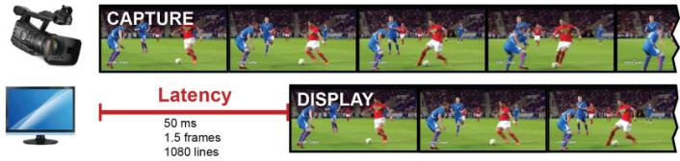
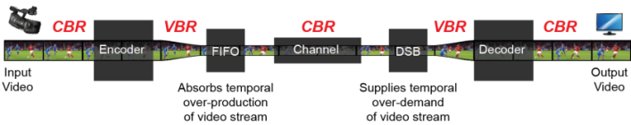
Real-Time Response
Live video streaming requires system low-latency
Notes:
Explain how end-to-end latency latency depends from buffering….

Slide 13
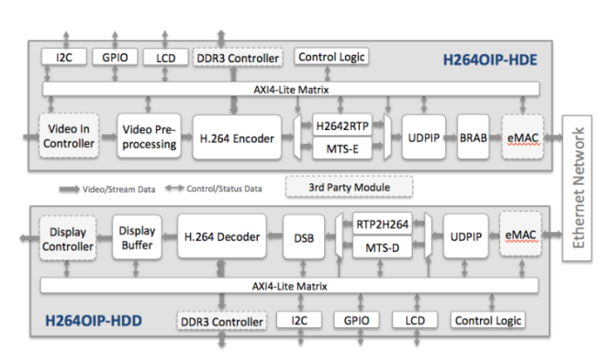
Subsystems for Low-Latency Performance
H.264 and MJPEG Video Subsystems with deep sub-frame,
end-to-end latency
Notes:
Implementing the connectivity to address the increasing needs

Slide 14
TSN Bridge Reference Design
Main Modules
TSNAVB_EP, UDPIP, & RTP hardware stacks
Ultra Low Latency H.264 encoder
IP Traffic Generator
Features
Controllable over Ethernet connection
Available on Intel and Xilinx Boards
Customizable

Slide 15
Save on Bandwidth and Storage, while Preserving Data Accuracy
Compression is key to reduce the networking
and storage cost, but full accuracy of
some types data needs to be preserved
  Industry-standard GZIP for sensor and
  other data
  JPEG-LS for image data - leading lossless
  compression efficiency and lowest complexity
  (silicon cost and power)
Standards allow interoperability with software systems
Notes:
Implementing the connectivity to address the increasing needs

Slide 16

WDR/HDR Increases Image Clarity
Essential for
machine vision
in vehicles
Improves image
quality to create
clear and sharp
images under any
lighting conditions
Processes the merging of 2, 3, or 4 exposures and provides tone mapping, white-balance adjustment, back correction and 2D noise reduction filter
Notes:
Implementing the connectivity to address the increasing needs

Slide 17

Preserving Vehicle Data-Security
Security standards are based on the same industry-standard algorithmic primitives:
  AES, AES-GCM, AES-CCM, AES-XTS,
  MD-5, SHA-1, SHA-256, Keccak/SHA3 …
GEON low-power, efficient processor security functions
  Protects sensitive code and data during execution, storage, and transfer to/from the processor

Slide 18
IP Products
COMPRESSION
Lossless Data Compression
GZIP/ZLIB/Deflate; Ref. Design
GUNZIP/ZLIB/Inflate
H.264/AVC Encoders:
Low-Power through Ultra-Fast; Intra-Only
H.264/AVC Decoders:
Low-Latency, Low-Power
JPEG & Motion JPEG:
Encoders & Decoders: Baseline, Extended 16-bit, Ultra-Fast
JPEG-LS Encoder & Decoder
Video Over IP Subsystems &
Ref. Designs
H.265/HEVC Decoder
Companion Cores
Image Processing
WDR/HDR
CAMFE Camera Processor
Network Stacks
40G & 1G/10G UDPIP Stacks
RTP Stacks for H.264 & JPEG
MPEG Transport Stream MUX
INTERCONNECTS
Automotive
CAN2.0/CAN FD, VIP
LIN, SENT, TSN Ethernet
Avionics DO-254
MIL-STD 1553, ARINC 429
SPI Octal, Quad; AHB, AXI; Master/Slave; Bridge
MIPI: SPMI & RFFE
I2C/SMBUS; PCI; Ethernet MAC
UARTS; SDLC & HDLC
CONTROLLERS & PROCESSORS
32-bit BA2x Family
Secure Processor: Geon
Application Processors
Full & Basic
Embedded Processors
Cache-Enabled
Deeply Embedded
PipelineZero Low-Power
Dev & Debug Packages
8051 Compatibles
PERIPHERALS
AMBA Infrastructure Cores
AHB matrix, multi-layer AXI, AHB/APB/AXI Bus-Bridges, DMAs, Peripherals & AHB Cache Controller
Device Controllers:
Smart Card Reader, Parallel NOR Flash & Serial Flash
Legacy Peripherals:
DMA Controllers, UARTs,Timer/Counter
SECURITY & ENCRYPTION
AES, Programmable,
CCM, GCM, XTS;
Triple DES
Hash Functions
SHA-3 (Keccak),
SHA-256, MD5
GEON – Secure Execution Processor

Slide 19

Learn more: www.cast-inc.com info@cast-inc.com
+1 201.391.8300
Thank
You.

