Slide 1


100% safe IP Core? –
CryptOne as an example of
new generation of secured IP Cores
Jacek Hanke, CEO Digital Core Design
Shanghai, China, Septemeber 12th, 2019

Slide 2
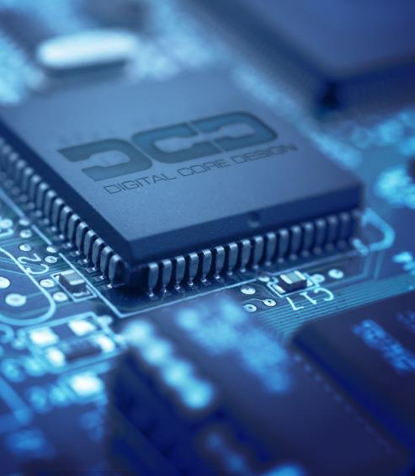
Agenda
About Digital Core Design
Milestones
Security vs hardware
CryptOne & I3C
Summary
Digital Core Design, All Rights Reserved, ©2019

Slide 3




Digital Core Design
Digital Core Design has been founded in 1999 and since the early beginings is focused in IP Cores improvement and System-on-Chip designs,
During these two decades, DCD’s launched more than 70 different architectures, among them e.g. World’s Fastest 8051 – the DQ80251 and royalty-free 32-bit CPU - the D32PRO,
DCD has sold more than 1000 license to various customers like corporations start-ups, R&D offices, universities and so on.
Digital Core Design, All Rights Reserved, ©2019

Slide 4





Milestones
CryptOne, 100% safe crypto CPU
19
D32PRO awarded with the „Teraz Polska” Prize
17
16
D32PRO, royalty-free 32-bit CPU
D32PRO named Polish Product of the Future
15
DCD among 4 most innovative companies in Poland
DQ80251, World’s Fastest 8051
Product of the Year Award DQ80251
EDN's Hot Products of 2012 for DQ80251 & DoCD
14
DoCDTM Hardware Debugger
13
DP8051XP
IP Core
DRPIC 166X IP Core EDN Hot 100 Products
13
1999 DCD
established
2011
05
12
12
02
DQ80251 presented at CeBIT 2013 opening ceremony
99

Slide 5
DCD’s IP Cores
500 customers
1000 licenses
More than
500 000 000 devices
our office

Slide 6
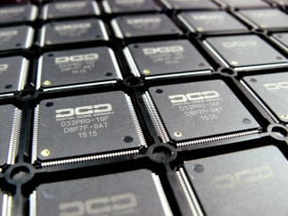
DCD’s IP Cores
One of the most experienced companies in IP Core market
More than 70 architectures in portfolio including 8-bit, 16-bit, 32-bit MCU, UART, I2C, SPI, I3C,
USB, CAN, CAN-FD LIN, floating points ...
Among them World’s Fastest & World’s Smallest 8051 & 80251
Deeply embedded, royalty-free, fully scalable 32-bit CPU
Technology independent (ASIC & FPGA)
IP Cores tailored to the project needs
Royalty-free solutions

Slide 7
Security,
stupid*
Encryption
Communication attacks: Man in the Middle, Weak RNG, Code vulnerabilities
Isolation
Software Attacks: Buffer overflows, Interrupts, Malware etc.
Anti-tampering
Physical Attacks: Fault injection: clock or power glitch, alpha ray, Side Channel Analysis (SCA), Probing, Focused in Beam (FiB) etc.
Security services
Life Cycle Attacks: Code downgrade, Excess manufacturing, Integrity vulnerabilities
There are a range of
attack types...
* Paraphrised: Bill Clinton 1993 „It's the economy, stupid”

Slide 8
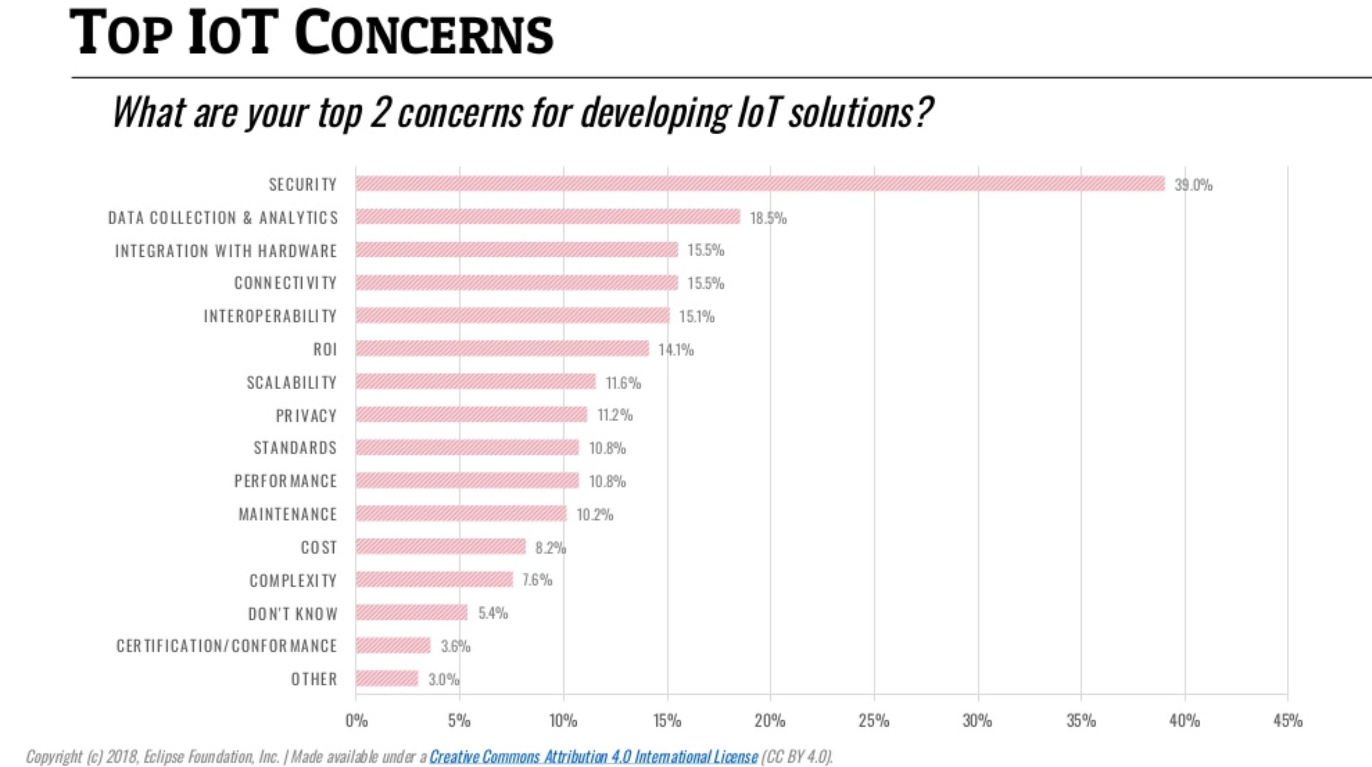

Secu
rity
is
impo
rtant?

Slide 9


Why security in HW is better than SW?
Faster: HW cryptography performs the encryption and decryption many times the speed of SW implementation,
Higher Performance, Lesser Code size,
Application Integrity Assurance: hardware root of trust is more secure & higher assurance of code integrity over software,
Resistance to Reverse Engineering: SF is more susceptible to RE
Resistance to Non-intrusive Attacks: SF is more vulnerable to attacks that are based on power consumption analysis
Higher level of Key Protection: keys are stored in HW not in SF

Slide 10


Security vs hardware
When implementing security countermeasures on an IoT device, best done using hardware based security
 | Software | Isolated Security IP (HSM) | HW-based security
Software attacks
Micro-architecural attacks
Physical attacks
Ready for the highest
Security level

Slide 11

Cryptone
CryptOne is a 100% safe crypto CPU, because...
It involves the use of RSA asymmetric encryption scheme to realize a cryptosystem with a one-time pad (OTP),
DCD’s solution is a broadly defined crypto system solution based on an asymmetric RSA with a hidden value of a component of a public key susceptible to crypto analysis and implementing the OTP rules,
Nowadays security is the key - that’s why CryptOne OTP offers the advantages of symmetric crypto systems with one-time pad while retaining the advantages of asymmetric systems.
Digital Core Design, All Rights Reserved, ©2019

Slide 12
Cryptone
CryptOne core is a universal, fully scalable solution which is able to boost asymmetric cryptographic algorithms like: RSA, Diffie-Hellman and ECC;
It provides the efficient solution for asymmetric cryptography boosting arithmetic operations like: modular exponentiation, multiplication, inversion, GCD finding as also point doubling;
The energy efficient architecture of CryptOne IP core enables the usage of the very small silicon footprint with high processing speeds.
Digital Core Design, All Rights Reserved, ©2019

Slide 13
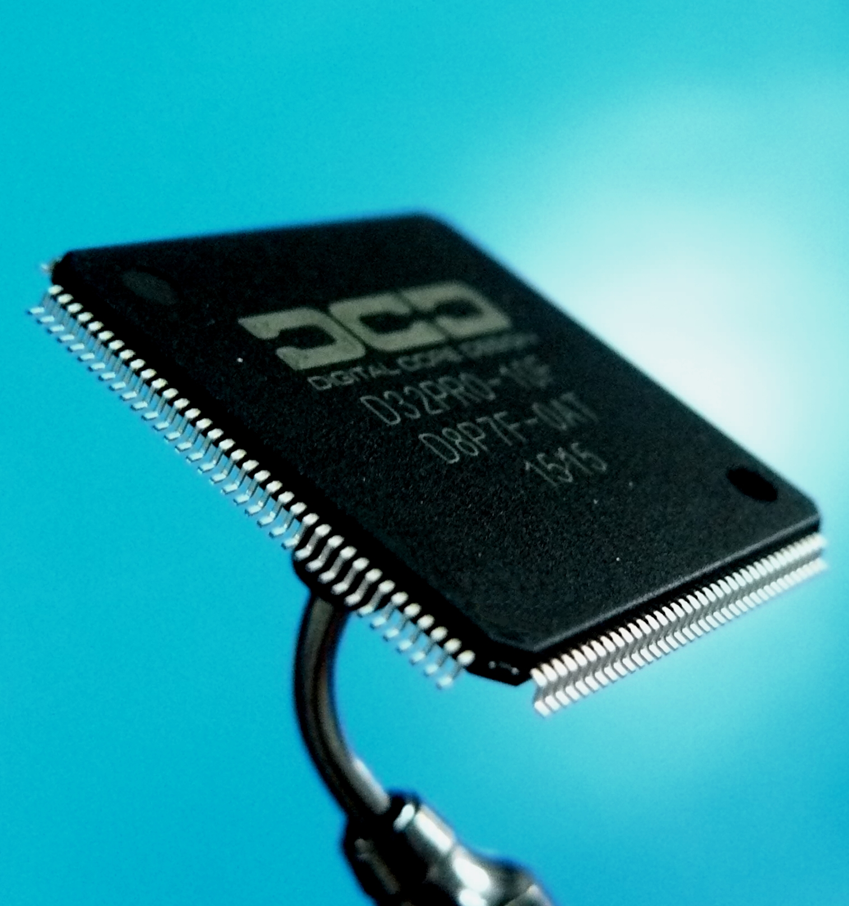
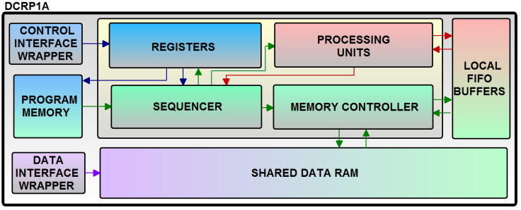
100% safe crypto CPU
CryptOne can be provided with various different interfaces including AMBA, AHB, AXI4, APB;
Very intuitive interface enables fast, straightforward system integration;
The core is resistant to the Differential Power Attacks (DPA) and timing attacks.

Slide 14
CryptOne’s features:
CryptOne constant time algorithms:
  Modular exponentiation,
  Parallel modular exponentiation CRT
  ECDSA sign/verify
  ECDH
  Elliptic curve point multiplication
  Modular multiplicative inverse
  GCD
  Modular reduction
  Multiplication
  Division
Cryptographic algorithm applications:
  ECDSA, ECDH
  RSA key generation
  RSA Sign/Verify/Encrypt/Decrypt
  Diffie-Hellman schemes
  Miller-Rabin Primality check
  System applications:
Client-server communication:
  Sensor networks
  SSL/TLS stacks
  IoT devices
  Embedded security/ID devices
AMBA AHB, AXI4, APB interface ready
Rapid & easy development with delivered API
Patent pending architecture
Algorithms resistant against SPA and timing attacks
CryptOne elliptic curves with native support:
  NIST P-192
  NIST P-224
  NIST P-256
  NIST P-384
  Koblitz P-192
  Koblitz P-256
  Koblitz P-384
  Brainpool P-256
  Brainpool P-384
  Brainpool P-512
  Other/custom curves optional support
Software support:
  OpenSSL engine
  MbedTLS port
  OS independent crypto library

Slide 15
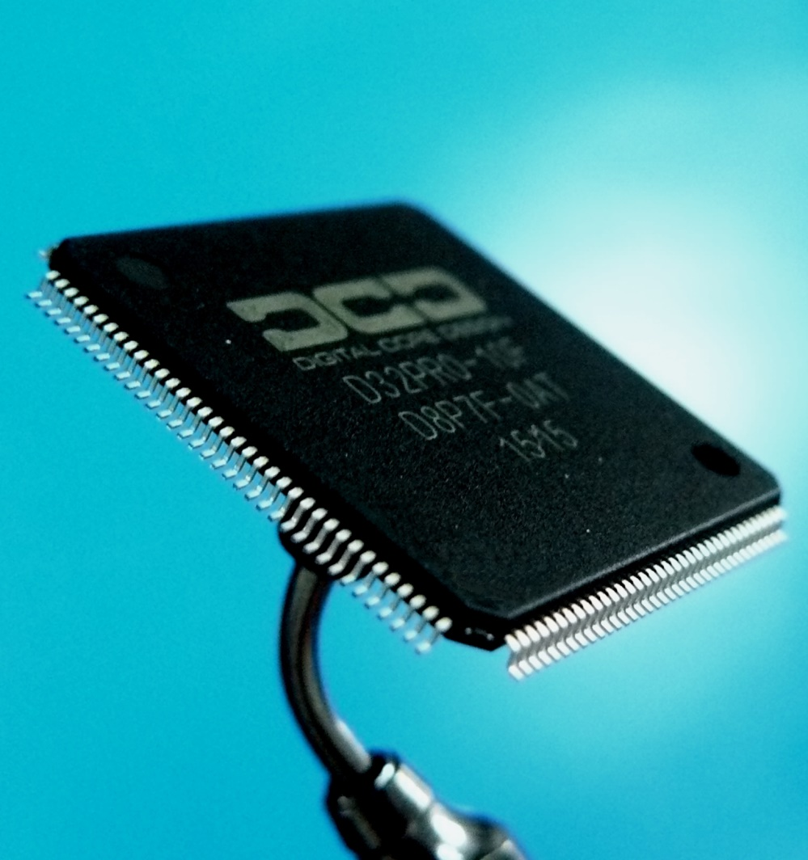
CryptOne – choose the best for you
CryptOne RSA
CryptOne EC
CryptOne TLS
○ Modular Exponentiation constant time operation algorithm support
○ Parallel Modular Exponentiation CRT constant time operation algorithm support
○ Secure private RSA key computation, no branch inversion
○ Easy to use software library interface
○ Elliptic Curves point multiplication constant time algorithm
○ Constant time modular multiplicative inverse algorithm for private operations.
○ Boost modular multiplicative inverse algorithm for public operations
○ Native support for most popular elliptic curves
○ Easy to use software library interface
○ Modular Exponentiation constant time operation algorithm support
○ Modular Exponentiation CRT constant time operation algorithm support
○ Secure private RSA key computation, no branch inversion
○ Elliptic Curves point multiplication constant time algorithm
○ Constant time modular multiplicative inverse algorithm for private operations
○ Boost modular multiplicative inverse algorithm for public operations
○ Native support for most popular elliptic curves
○ Modular Reduction constant time algorithm
○ Greatest Common Divisor algorithm
○ MbedTLS and OpenSSL port libraries
○ Software interface and examples for building own hardware algorithms with support for:
○ Large vector addition/subtraction
○ Large vector shift right/left
○ Large vector modular multiplication
○ Branch, execution flow controls

Slide 16
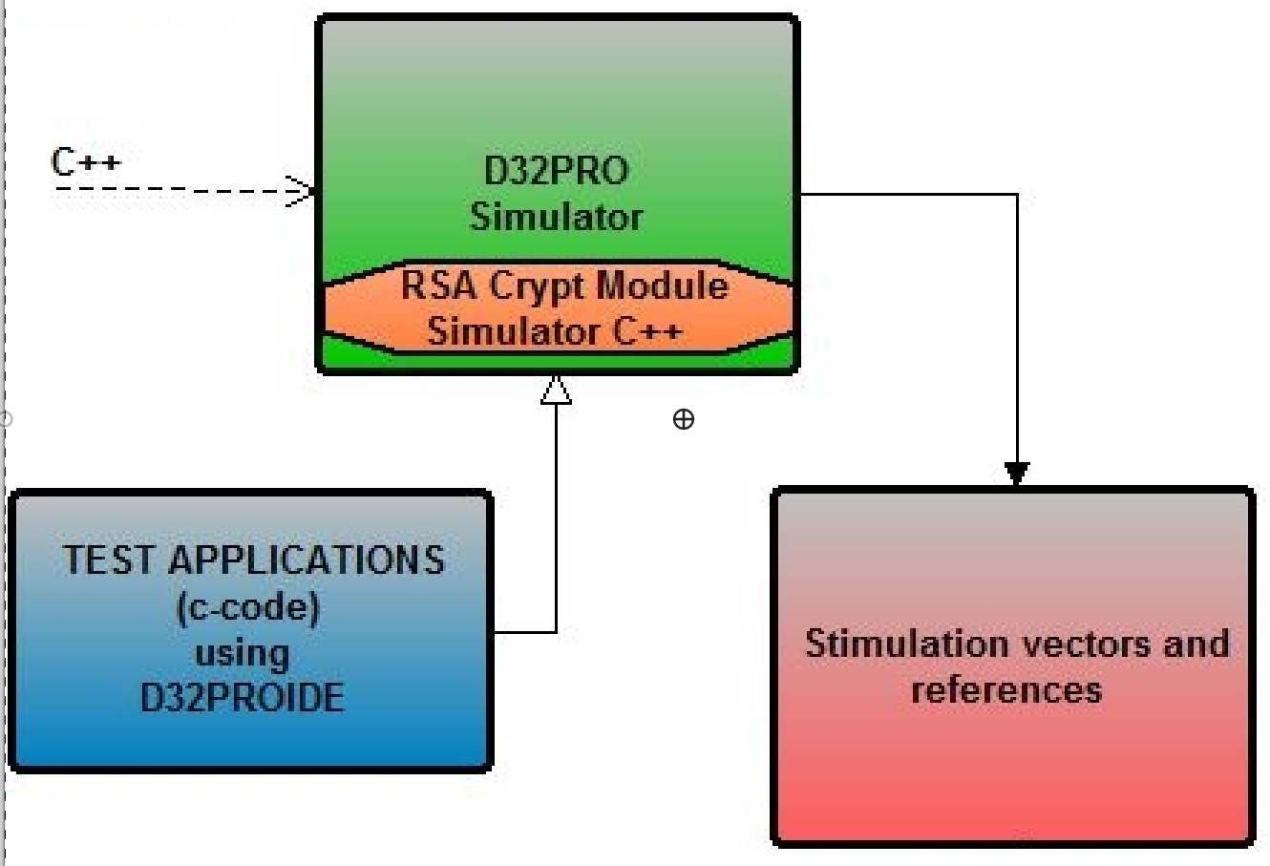
100% safe crypto CPU
CryptOne consists of technologically independent hardware crypto processor in the form of synthesizable IP Core module prepared for integration and implementation in an IC (ASIC or FPGA)
CryptOne offers both software
and hardware cryptography advantages
Software

Slide 17
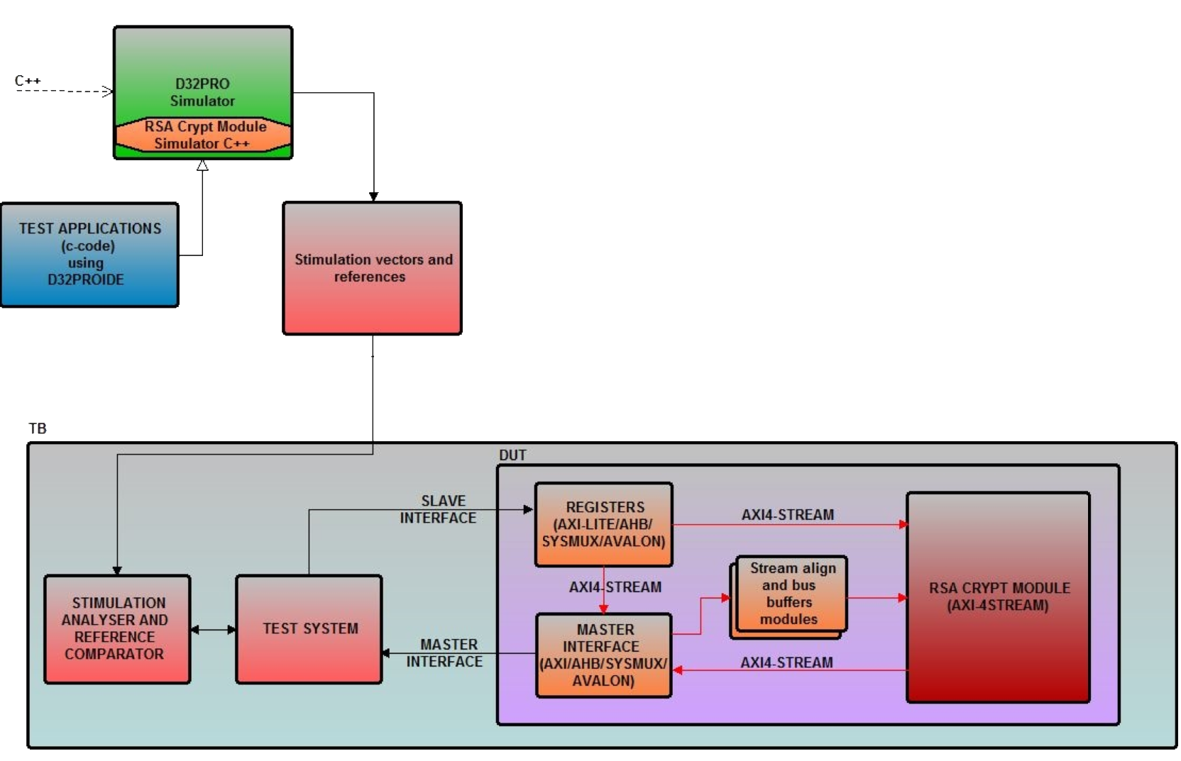
CryptOne
Hardware & software co-design
Test stimulation vectors are generated with the usage if D32PRO Simulator – the sub-module for RSA crypter is written in C++
All tests are written in C using D32PRO software – they can be easily used in hardware through D32PRO platform
Generated stimulation vectors are also used for reference comparison
All internal data is exchanged through the AXI4-Stream protocol in simple format = higher flexibility
The internal RSA CRYPT MODULE can work in a separate domain
Software
HARDware

Slide 18
Receiveables
C software drivers with API
Silicon proven architecture
Hardware code:
● VERILOG Source Code or
● FPGA Netlist
VERILOG test bench environment
Technical documentation
Synthesis scripts
12 months of free technical support included

Slide 19
DI3CM-FIFO
The DI3CM-FIFO Core incorporates all features required by the latest
MIPI I3C specification;
The I3C (Improved Inter Integrated Circuit) is the next generation from I2C; keeping the best assets from its elder brother, the I3C has major improvements in use and power and performance;
The Core uses just two pins and consumes a fraction of the energy, reducing cost and complexity while allowing multiple sensors from different vendors to be easily interfaced to a controller or application processor;
DCD maintains backward compatibility, to enable a smooth transition from I2C to I3C and focus on simple implementation;
The newest Core offers a flexible multi-drop interface between the host processor and peripheral sensors to support the growing usage of sensors in embedded systems.

Slide 20
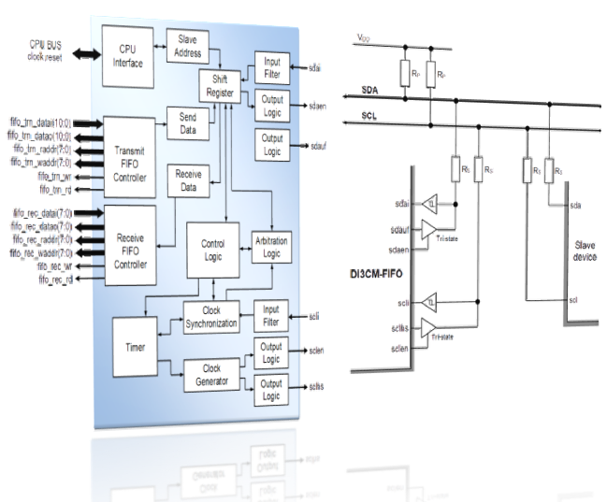
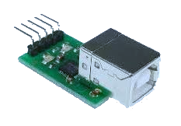
DI3CM-FIFO
Conforms to MIPI I3C v1.0 specifications
MIPI Manufacturer
ID: 0x03B3
Dynamic Addressing while supporting Static Addressing for Legacy I2C Devices
Legacy I2C messaging
I2C-like Single Data Rate messaging (SDR)
Master operation with FIFO:
Master transmitter
Master receiver
Supports flexible transmission speed modes:
FAST-PLUS (up to 1000 kb/s)
SDR (up to 12,5 Mb/s)

Slide 21
DI3CM-FIFO
Multi-master systems supported & interrupt generation;
Allows operation from a wide range of input clock frequencies (build-in 12-bit clock timer);
Configurable interface allows easy connection to standard bus interfaces: APB, AHB, 8051, 80251, others;
Fully synthesizable, static synchronous design with positive edge clocking and synchronous reset;
Support for I3C common command codes & in-band interrupts;

Slide 22
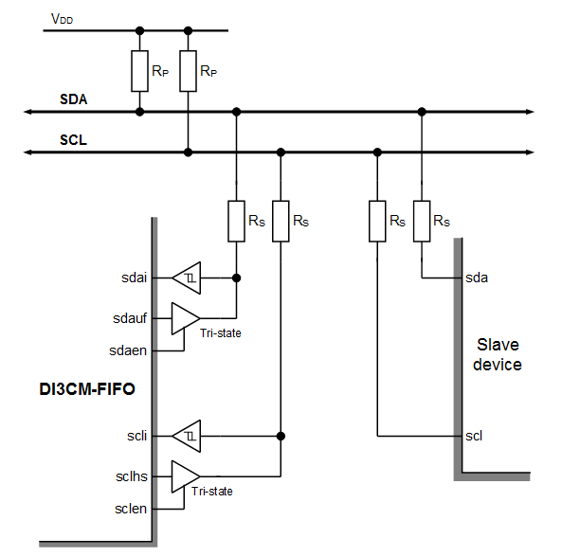
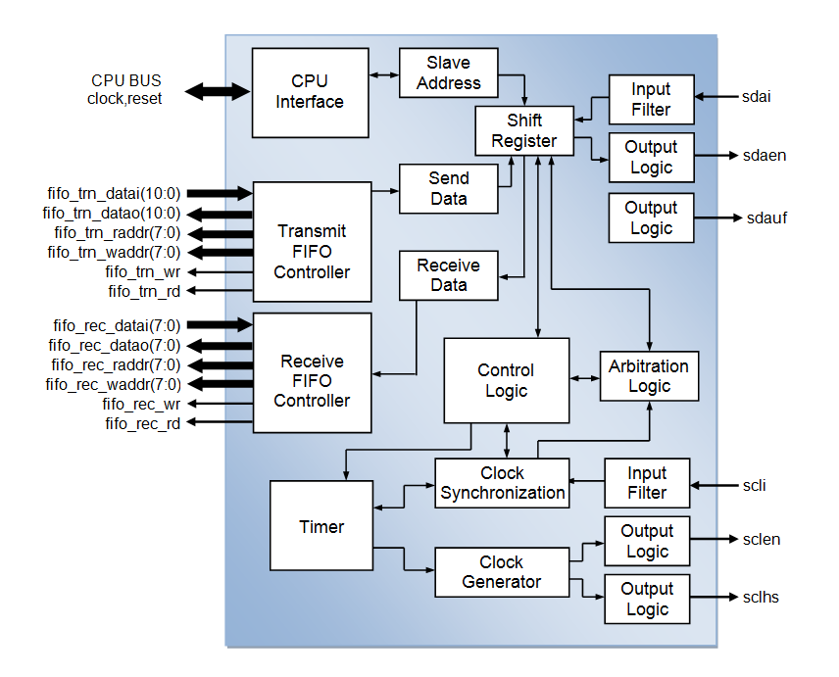
DI3CM-FIFO
Embedded microprocessor boards,
Consumer and professional audio/video,
Home and automotive radio,
Low-power applications,
Communication systems,
Cost-effective reliable
automotive systems.

Slide 23
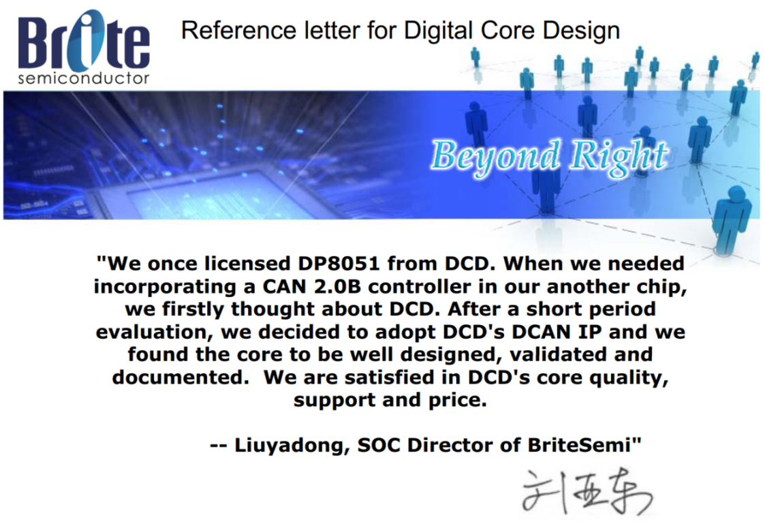
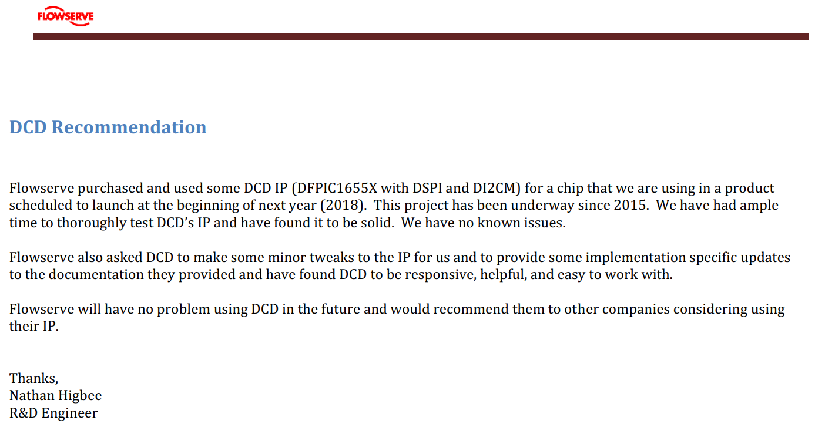
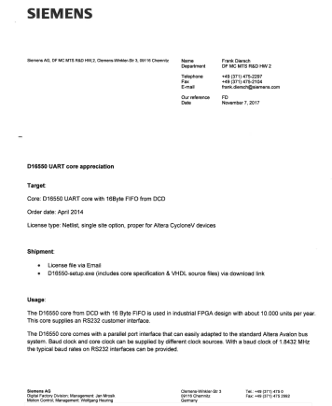
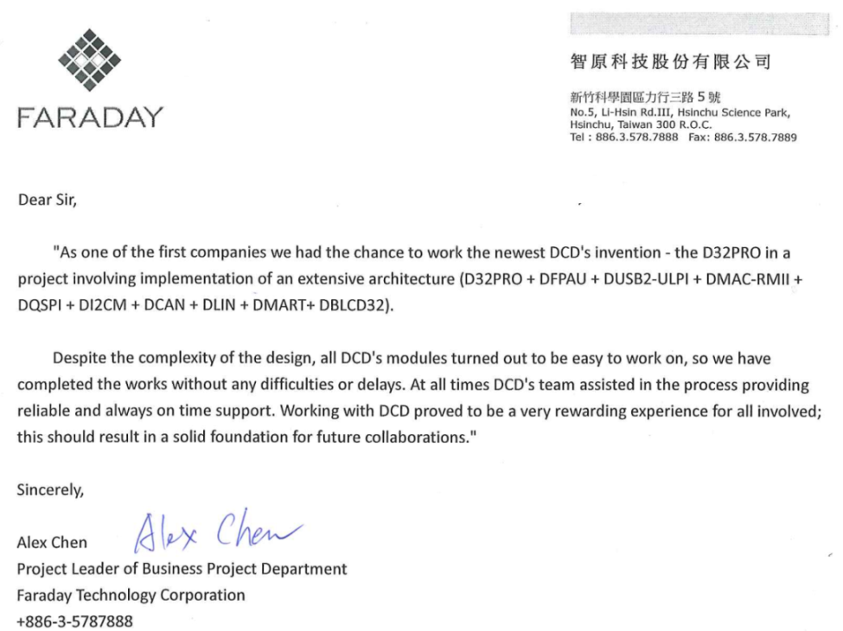
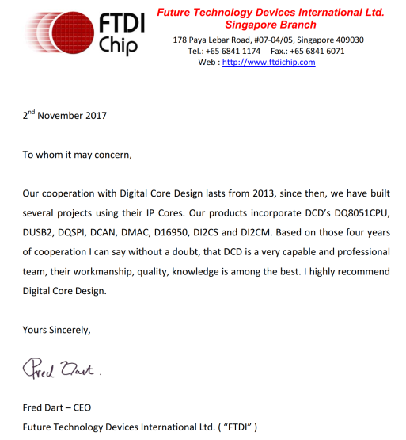
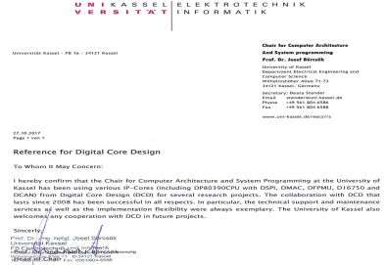
Summary
Success stories are the best confirmation for DCD’s quality

Slide 24
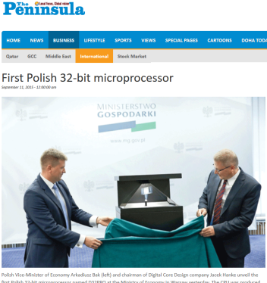
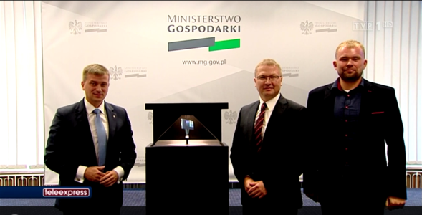
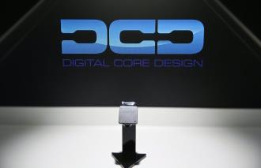
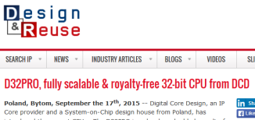
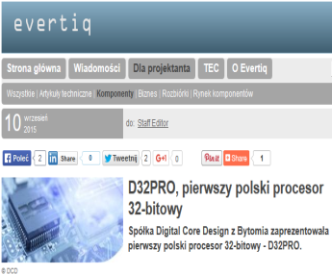
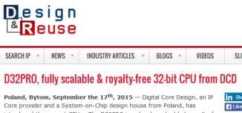
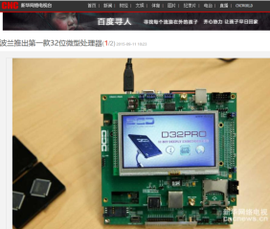
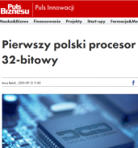
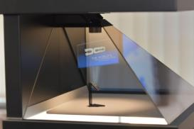
Why DCD?
Two decades of IP Core market experience

Slide 25
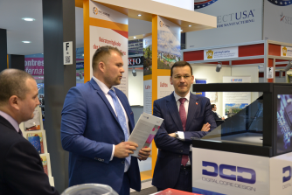


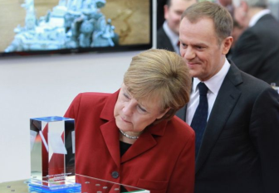
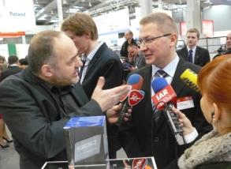
Why DCD?
DCD presented World’s fastest 8051 CPU during CeBIT 2013 official opening ceremony (in front of German Chancellor A. Merkel and EU President D. Tusk)
D32PRO has been presented during EXPO in Milan and Hannover Messe

Slide 26
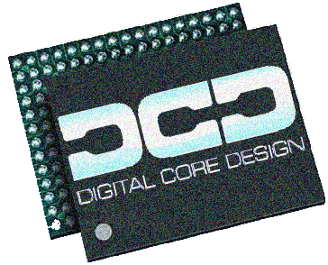
Why DCD?
Innovative products – always step ahead before competitors
Know-how based on two decades of market exprience
Optimal solutions which answers market needs
Significant Time-to-market reduction
Coherent IP Core portfolio
IP Cores tailored to the project needs
Complete solution from one company
like e.g.: IP Core + debugger + ...

Slide 27
Thank you!
Any questions?
info@dcd.pl

