Slide 1
Ultra-low Power for Always-on with Minima Dynamic Margining
Lauri Koskinen, CTO, Minima Processor

Slide 2
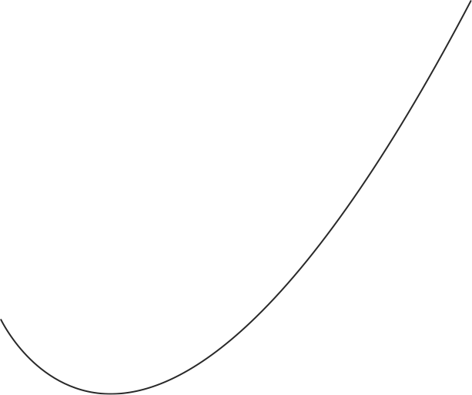
Lowering Voltage and Energy in Real Time 101
Run to
Completion
Quadratic
Energy Savings
Higher energy
Just-in-Time DVFS
Task
DL
Higher voltage
Time
Near-Threshold
Operation
Notes:
Embedded many times single task
Voltage scaling required

Slide 3
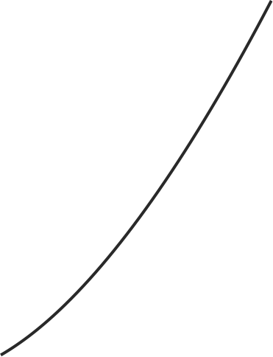


Ultra-Wide DVFS required
AI
UP TO 15x
Energy
Loss
AUDIO
Detection
BLE
LINK
AUDIO
No detection
Higher energy
BLE
L2CAP
Higher voltage
Legacy µC,
1-2 VDDs,
CLK scaling

Slide 4
With E= CV², Much Left on the Table
10
9
Audio
BTLE
Crypto
Video
WIFI
GPS
High perf
8
UP TO 15x
7
6
5
4
3
2
1
0
Energy savings
Conventional technology
Notes:
Tässä on tärkeätä käydä law of diminishing returns läpi

Slide 5
Real-World Measurement Examples
SHA256, Commercial DSP IP
Keyword spotting: 2,6x energy savings
  ARM KWS reference SW split into two tasks:
    Speech-band energy detection (20 MHz / ARM M3)
    CNN (200 MHz / ARM M3)
  Higher energy saving with low-activity data (silent room)
Operation point change overhead:
  250 cycles (SW) + 550 cycles (DCDC 15 mV/µs)
3,5x Energy
Savings
Notes:
Ts. KWS ~ 10MCycleä ja BandPass ~ 0.8MCycleä, Ja nämä ajetaan siis 10 x sekunnissa.
Delay = (20e6 MHz)/(1e6 us)*(900mV-500mV)/15mV/us
Image recognition / vehicle classifier: Nx
Five-layer CNN (X MHz / ARM M3)
Split X and Y
Bluetooth Low Energy stack: Nx
Split X and Y

Slide 6
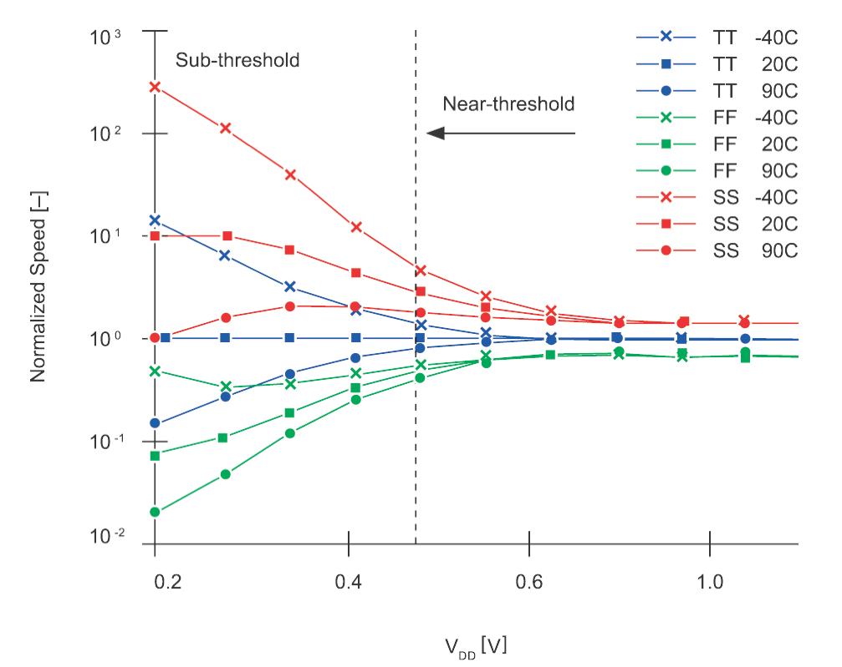
The Challenge
Margins

Slide 7
Solution: Margin Dynamically
Conventional
Design
CLK
Process
Voltage
Temperature
Minima
Margining Pre-Silicon
CLK
Feedback loop delay,
Gate functionality, etc.
Minima
Margining
Working Silicon
CLK
With DVFS intermittent large margin averages => 0

Slide 8
Create Feedback Loop with In-Situ Monitors
Detections
CLK control

Slide 9
Several Feedback Loops Required
Power profile
VDD, Freq.
Clock phase
SW
OS governors,
Power profiles,
Minima drivers
HW
Minima clock architecture
HW
Minima PM
Single cycle
Tens of ns
Interrupt

Slide 10
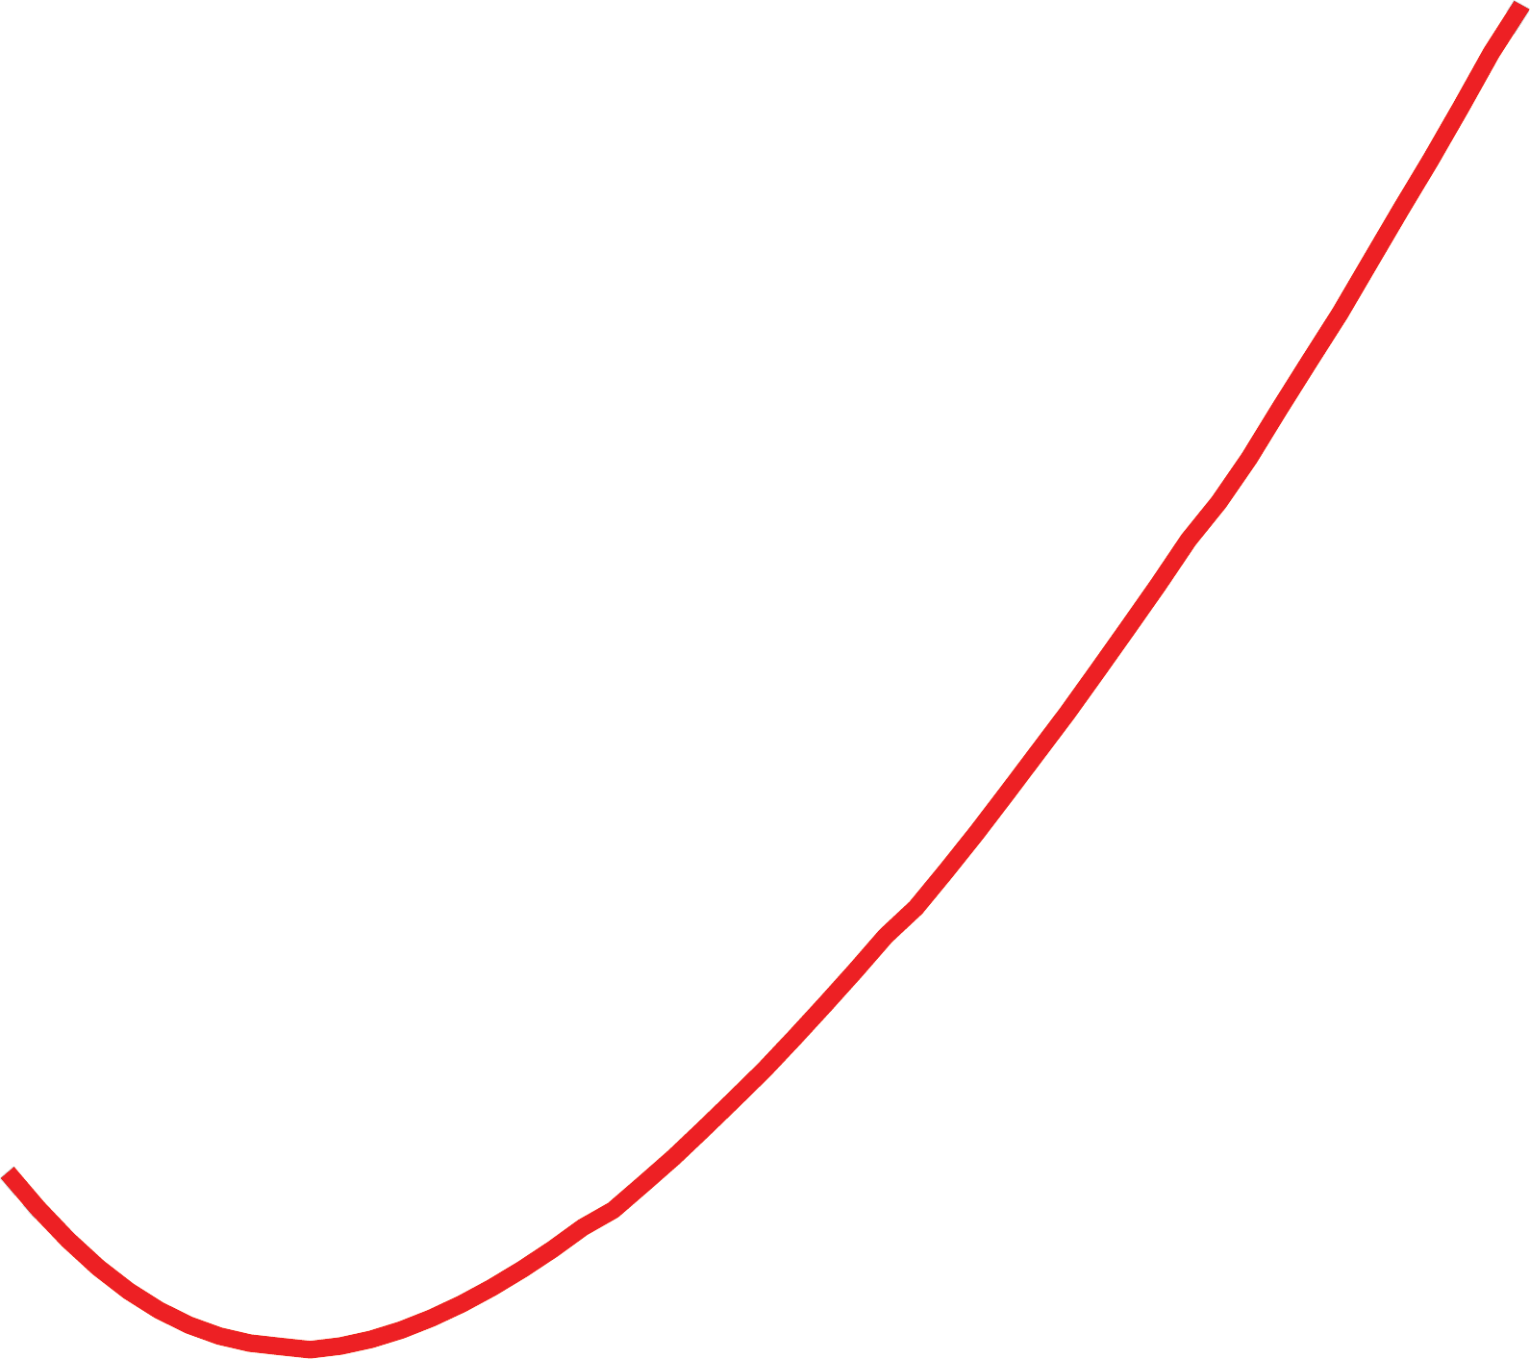
Loops in Dynamic Margining
BTLE Stack
@ 0.7V, 64MHz, SS chip
Housekeeping
@ 0.4V, 2MHz, SS chip
Minima HW – SW Interface
Housekeeping
@ 0.35V, 2MHz, SS chip

Slide 11
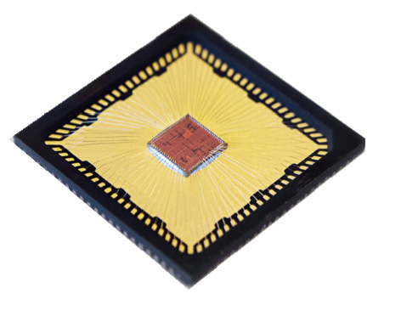
1st Feedback Loop Measurements
1

Slide 12
2nd-Order Benefits: Power Distribution
SS limits speed
Reduced power variation!
FF sets the high power point (and leakage)
UW-DVFS Power Spread Up To 2x
Notes:
Mainitse Temperature inversion:
“With NT, temperature inversion complicates things even more. I’ll let you figure out what the most power hungry point is at worst temp”

Slide 13
Minima: The Product
Minima API analyzes your code for optimal energy states
Application Code
Easily integrable driver offers constant performance or energy minimization per application or data
RTOS
DVFS Drivers
Ultra-Wide DVFS HW
enabled by Minima soft IP
Minima technology integrable to any IP:
ARM, RISC-V, DSP

Slide 14
Final Thoughts
Radio energy: 100 nJ/bit (Zigbee), 50.00 nJ/bit (BLE), 3.70 nJ/bit (Wifi)
Memory energy: ~100pJ
  Local memory accesses, DRAM accesses
  Flash much more
Processor energy today: ≥~50pj
(CMOS) Processor minimum energy ~5pj
Memory compression becomes cheaper in terms of energy
Edge computing (contextual computing, fog computing, etc.) becomes cheaper in terms of energy
Acknowledgements Ali M. Niknejad
Notes:
Firman täytyy tarjota muistikompressio hardista ja edge koodia!

