Slide 1
中国智造，创芯中国
Zhuhai, China
OTP IP
rorlando@chuangfeixin.com
wangzhigang@chuangfeixin.com
WWW.CFX-Tech.COM

Slide 2
CFX OTP Advantages
Gate Dielectric Anti-Fuse OTP
CMOS Process Compatible – No Additional Masks/Costs
Most Reliable NVM Data Retention – Harsh Environments
Small Die Area
One Time Programmable – Cannot Be Changed
Closes the “Backdoor” of OTP in other NVM
Ease of Integration

Slide 3
Gate Dielectric Anti-Fuse
Capacitor Structure using Gate Oxide Dielectric
Applying High Voltage across cap creates oxide breakdown
Oxide Breakdown creates Conductive Path though Oxide
Unprogrammed
Programmed
R > 1G Ohm
R ~ 100K Ohm

Slide 4
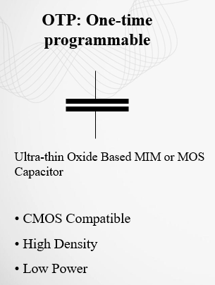
OTP Anti-Fuse
Antifuse
Select transistor
Protected by Patents
CN104681558A 12/3/2013
CN103745977B 4/23/2014

Slide 5
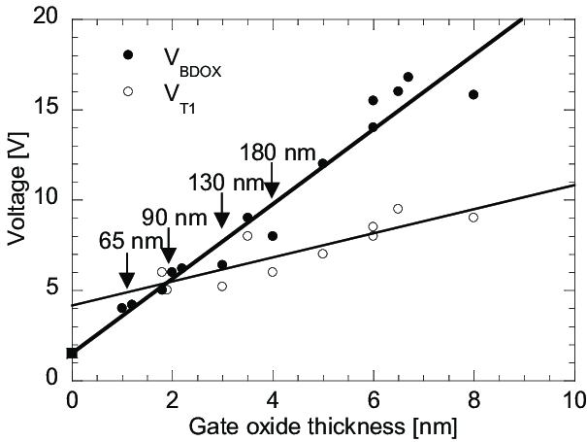
Gate Oxide Anti-fuse in CMOS
Breakdown voltage is based on Gate Oxide thickness
Standard CMOS process does not have HV transistors
Gate Oxides < 40 Angstroms require Vprog ~ 8 volts
Source “Closing the design gap between system-level and component-level Electro Static Discharge (ESD)”, Scholz, Mirko, 2013/05/29

Slide 6
Gate Oxide Anti-fuse in CMOS
Device Scaling below 130 nm has reduced programming voltages to < 10 volts
Further Scaling/Vprog reduction makes Dielectric Anti-fuse the OTP of choice
Standard CMOS Floating Gate becomes impractical
Gate Oxides are too thin
Standard CMOS process and devices
Ultra Low Power
1T 1C Cell Scales with Process
Mbit Densities are Practical
High Temperature Operation
Up to 175 Deg C
Secure
Non-Alterable
No Reverse Engineering Contents

Slide 7
Data Retention- 250 deg C 48h
4Kbits without Deep MPwell

Slide 8
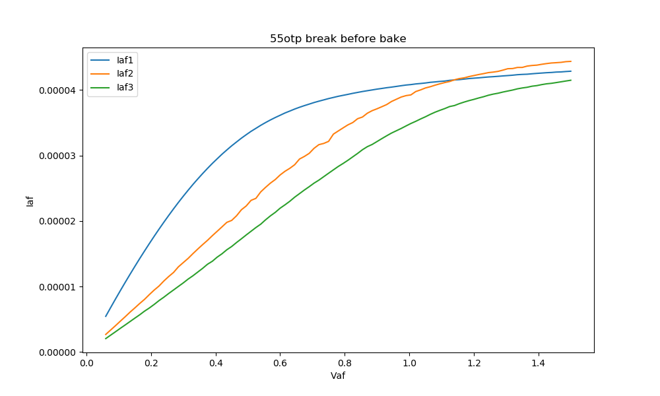
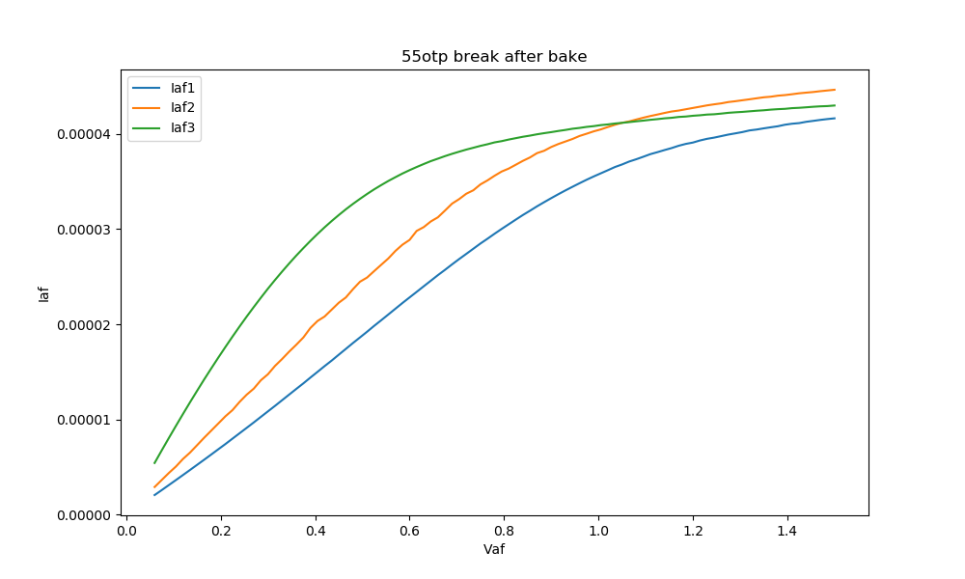
Data Retention – iRead 24h 250 deg
Before Bake
After Bake

Slide 9
The Award Nominee
4KB MTP - DB HiTek 110nm 1.5V/3.3V Logic Process
◆ Power Supply
2.8V VDD (±10%)
With internal high voltage charge pump
◆ Memory size 4K-byte
◆ Program Times: 3
◆ Bit Program Operation
◆ Byte Read Operation
◆ Junction Temperature TJ : -40°C ~ 125°C
◆ Data Retention: >10 Years @ 85°C

Slide 10
4KB MTP Specifications
◆ MTP Cell :1.5V device
◆ IP Size : 0.283mm^2
◆ Byte Access Time :0.1μs (typ)
◆ Bit Program Time : 0.1ms (typ)
◆ Operating Current :
IVDD_R: 520 μA (typ)
IVDD_P: 920 μA(typ)
◆ Standby Current :
IVDD_SB : 0.1μA(max)

Slide 11
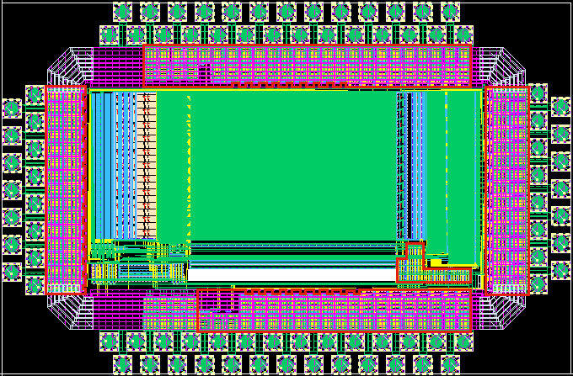
512Kb OTP Specifications
Process: Silterra110nm 1.5V/3.3V Ultra Low Leakage Logic Process
Density: 16Kx32bits
Bit Program Operation
32bits Read Operation
Operation Temperature: -40°C ~ 125°C
IP Size: 1340um * 670um
WL Decoder
OTP Array
Redundant
Block
BL Decoder
Analog Modules

Slide 12
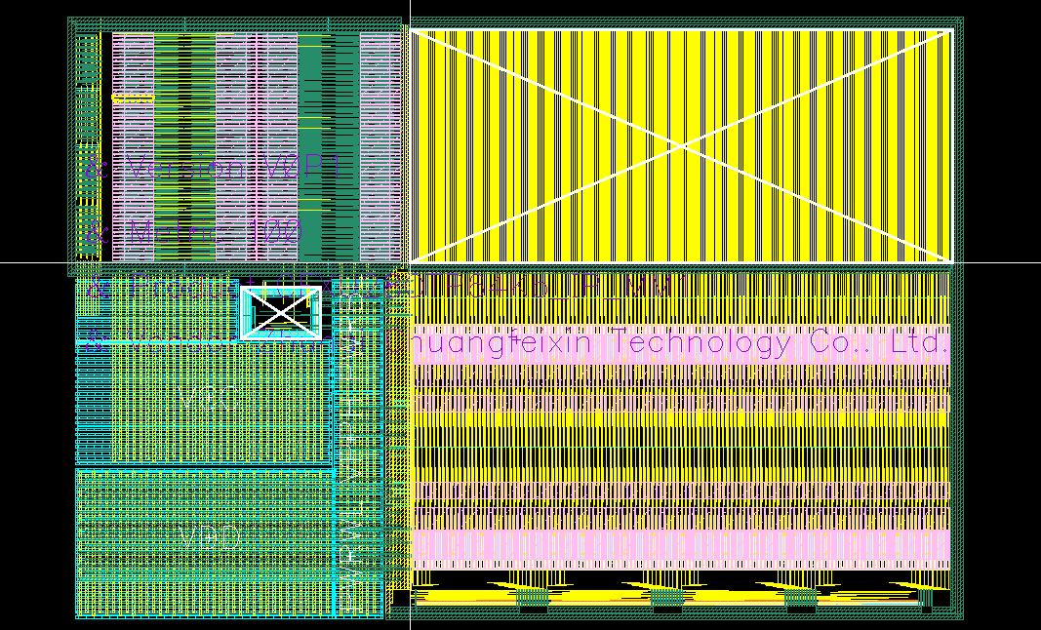
64Kb OTP Specifications
decoder_8to255
Process:UMC28nm Logic and Mixed-Mode High Performance Compact Plus Process
Density:64Kbits
Operation Temperature:-40 ℃ ~125℃
Bit Program Operation
IP Size：400um*270um
Bit Read Operation
Decoder 8-255
BL_level_shift
ARRAY
WL_level_shift
STM/SA/VB/LS
TOP_CAP
PL_level_shift
decoder_8to255

Slide 13
Competitive Comparison

Slide 14
OTP Foundry Status
 | SMIC | Silterra | Dongbu | HLMC | GF | CanSemi | SiEN | UMC | Huahong | GTA | Powerchip | CSMC | Samsung
180nm Logic |  | LV |  |  |  |  | ED |  |  | ED |  | LV
180nm BCD |  |  |  |  |  | D
160nm HV | P | P |  |  |  |  |  |  |  |  | P
160nm HV 5V |  | D
130nm logic | P | LV
130nm HV |  | P
110nm Logic |  | SP | D
110nm HV |  | P |  |  |  |  |  |  |  |  | P
90nm BCD |  |  |  |  |  |  |  |  | ED
90nm Logic |  |  |  |  |  |  |  |  |  |  |  |  | P
55nm HV | SP |  |  | ED
40nm EHV | ED
40nm Logic | ED |  |  |  |  |  | ED
28nm HKMG |  |  |  | ED |  |  |  | ED
22nm FDSOI |  |  |  |  | SP
14nm Logic | ED
Note:
ED | Early Development
D | Development
SP | Silicon Proven
RP | Risk production
LV | Low volumn production
P | Production

Slide 15
CFX OTP Design Flow
We do all the work
You specify the details
Organization, interface, supply voltages
We provide you with an embeddable block
IP Merge at Foundry
Data Sheet
Interface
Verilog Model
Complete Solution
Programming Circuits
Charge Pumps

Slide 16
OTP Applications
Logic Output
Cells are always in Read Mode – Instant On
Cell Outputs are used as logic signals
Architecture is n wide x 1 deep
Programming Interface
OTP Block
N Outputs

Slide 17
OTP Applications
Memory Array
OTP has Memory Interface
Read and Program
Address and Data Bus
Organized as n x m
Address Bus
OTP Block
Data Bus
Control

Slide 18
Modern OTP
Traditionally, OTP is programmed in external programmer
Modern Programming Voltages and Currents are Low
Charge Pumps and Programming Circuitry “Built In”
OTP Can be used for On-line, In-Situ Programming
Opens New Class of Applications

Slide 19
OTP Applications
OTP is a complimentary technology to other NVM
Traditional Applications
Serialization
Product Configuration
Yield Improvement
Trimming
Timing
Security
Emergence of IoT has creates new OTP Opportunities
Control of OTA updates
Programmable Analog creates new OTP Opportunities

Slide 20
OTP is Everywhere
Consumer | Code Storage, ECC and redundancy, Security keys, Configuration | Set top boxes, multimedia SoCs, application processor, gaming, GPS and storage
Mobile | Code Storage, ECC and redundancy, Security keys, Configuration | CMOS image sensor, baseband processor, RF transceiver, power amplifier, display, mobile DRAM, mobile SRAM, power management chipsets
Analog/Mixed Signal | Configuration, Calibration/Trimming | Amplifiers, ADCs/DACs, PLLs, audio/Display drivers, PMUS and telecommunications
Industrial | Code Storage, ECC and redundancy, Security keys, Configuration | Sensors, motor control, MCU, RFID, power control and video surveillance
Automotive | Code Storage, ECC and redundancy, Security keys, Configuration, Calibration/Trimming | Control systems, DSPs, in-car communication and in-car entertainment system
Mission-critical | Code Storage, ECC and redundancy, Security keys, Configuration, Calibration/Trimming | High-speed Rail/Aircraft/Satellite/Cruise missile/Space shuttle control

Slide 21
Product Configuration
SOC Tooling is Becoming Expensive
Different Applications or Usage Cases Create Proliferation
OTP Allows Configuration Selection
Single Mask Set
Single Test Platform
Higher Volumes, Lower Costs

Slide 22
Yield Improvement
Single Processing Defects can affect large blocks(Array Based)
Memory(DRAM/SRAM)
Image Sensors
Logic(Gate Arrays)
Column Drivers
OTP is used at Test to map in redundant rows/columns
Increase Yields

Slide 23
Timing
Oscillator Trimming
Eliminates process variation
Frequency Selection
Clock Divider Selection

Slide 24
Security
Unique Product Identifier
Encryption Passwords
Standardized Security Schemes
HDMI
WiMax
BlueRay

Slide 25
RF Tags
High Security
Read on Power Up
Low Power During Read is Critical
Ultra Low Sleep Power
Low Power During Program
Program All Locations to Disable

Slide 26
Analog IC Design Challenges
CMOS Process Variation
Inductor +/-1%
Gate Capacitance +/-5%
MIM Capacitance +/-15%
Parasitic Capacitance +/-15%
Next to Impossible To Design Analog in CMOS without Trim

Slide 27
Analog IC design
More and More Analog is Implemented in Standard CMOS
SOC including Analog Block
Interface is often Analog Intensive
High Speed Digital is Analog
Advanced CMOS Process Manufacturing Variations
Difficult to Meet Desired Analog Specifications
Trimming is Required to Meet IC specifications
Calibration is Required to Meet System Specification
OTP is ideal for both

Slide 28
Programmable Analog
One Chip can be used for multiple designs
Compensates for variation in system requirements
Examples
Voltage Levels
Timers
Sensing Inputs

Slide 29
Prog. Analog - Battery Management
Compensate for Variation in Battery Architecture and Chemistry
Charging Current
Charging Voltage
Charging Profile
Voltage Sensing Levels

Slide 30
Prog. Analog- Display Driver
Compensate for Panel Model Variation
Gamma Curve
Compensate for Panel Manufacturing Process Variation
VCOM Setting
Gamma Calibration

Slide 31
Prog. Analog- PMIC
Output Voltage Levels
Sequencing and Timing
Voltage Sensing Levels – Resets
Ramp Rates
Alarms
Overcurrent Limits
Temperature Limits

Slide 32
Prog. Analog- Programmable Vref
Eliminates traditional external voltage Divider
Eliminates Variations
Resistor Tolerance
Chip-to-Chip Variations

Slide 33
OTP in IoT
OTA updates key feature
Product improvements, bug fixes
Open the door to hacks
OTP is used as Primary Boot
Cannot Be Changed
OTP Used as Code Revision Counter
Insures the Integrity of the Code

Slide 34
CFX OTP IP
Standard Logic CMOS Process ;
Simple Integration Flow ;
Scalable from 350 to <10 nm ;
In-System Programmable ;
High Reliability (> Mil Spec) ;
Secure ;
High Density ;
Low Cost ;
Patent Protected ;
Volume Proven (>1B served, like McDonalds) ;
Local Support Zhuhai, Beijing, Shenzhen) ;
创芯中国 ;

Slide 35
CFX OTP IP - A Worldwide Sensation
OTP IP Devices
1 Billion

