Slide 1
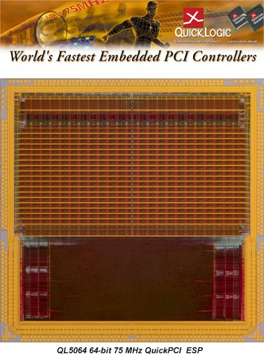
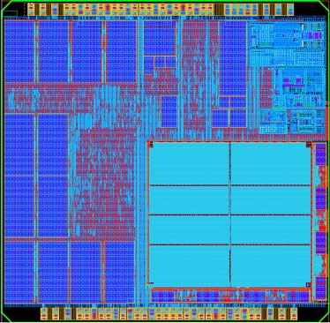
History on eFPGAs
1999 - 1st eFPGA used in SoC
Process: 0.35um
eFPGA LC size: 145um x 170um
24,650 um²
2002 – QuickMIPS Multi-core SoC
Process: 180nm
eFPGA LC size: 99um x 94um
9,306 um²
2017 – EOS S3 Multi-core SoC
Process: 40nm
eFPGA LC size: 31um x 31um
961 um²
eFPGA
eFPGA
eFPGA
PCI
Notes:
In 40nm is only roughly 10% of what it used to be 15 years ago

Slide 2
eFPGA Benefits Adding Post-Fabrication Flexibility to SoCs
Adds Flexibility – Enables complex functionality
Ultra-Low Power Consumption – Power optimized
Increased Performance – Eliminates chip-to-chip delays
Higher Revenues – Enables multiple product variants
Greater Profits – Closer match to market needs
Lower R&D Costs – Reduces development time & cost
Faster Time to Market – Supports post-fabrication changes
2

