Slide 1
Technical Problems UltraSoC Solves
UltraSoC IP
What is the mismatch between the host & the DSP?
Why is the CPU not as fast as expected?
SM
SM
SM
SM
Debug
Hub
SM
SM
Can I trust system security?
Why do some DMA transfers take too long?
BM
UltraSoC
Infrastructure
SM
Why does the system occasionally hang or deadlock?
What is going on with my memory controller?
BM
Why is my interconnect slower than I expected?
SM

Slide 2
Advanced Debug for the Whole SoC
Modules are protocol aware and “smart” with filter and trace
Portfolio of configurable modules, optimized for different system IP blocks
Flexible scalable message fabric, easy to route
Debug & trace is transparent: does not impact system bus
Supports subsystems with different power domains, clock domains
Notes:
Talk about 3 types of blocks: monitors, message infrastructure and communicators
Upstream message to configure
Downstream for trace and analytics data
Mention not shown is the ability to pass signals/gpios

Slide 3
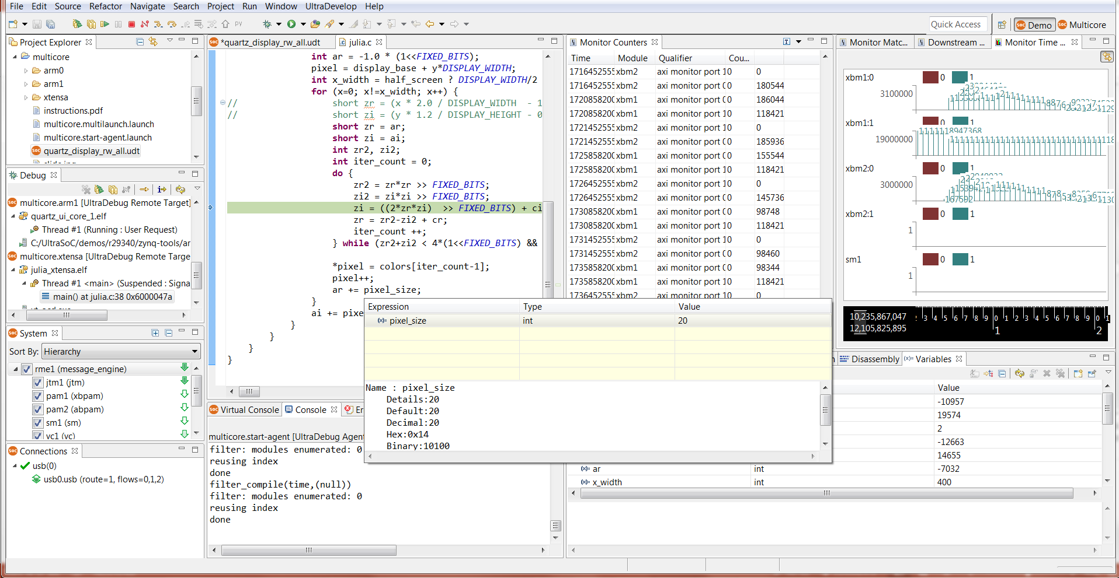
UltraSoC IDE
Visibility of software
Bus activity
Control configuration

